Slide 1
AgriLife Employee
Development Symposium

Slide 2
PROCUREMENT
UPDATES
Lindsay Weber
Assistant Director of Procurement
Notes:
Lots of info to cover
Please save questions until the end of both presentations
If we don’t have time during the session, I’ll be available to chat afterwards
1st update is ‘Purchasing’ has changed to ‘Procurement’!

Slide 3
STAFFING CHANGES
Chris Chamberlain
Director of Procurement & HUB
Noel Mason
Senior Buyer
Lindsay Weber
Assistant Director of Procurement
Nick Galetka
HUB Coordinator
*Started 3/20/23*
Jessica Campbell
Buyer I
*Started 1/17/23*
Vacant
Buyer I
*Interviewing Soon*
Carsyn Burney
Buyer I
*Started April 2022*
Lainey Calder
Buyer I
*Started April 2022*
Notes:
Core is still the same – Chris, Lindsay, and Noel
Several new faces:
Carsyn & Lainey – joined the team in April 2022
Jessica – started in January
Nick – started 9 days ago
Enews about Spot Bid Fair has gone out
Please follow instructions in that correspondence to submit items
Very important HUB event & we need to have a good showing

Slide 4
PROCUREMENT TEAMS
Team A
Lindsay Weber,
Carsyn Burney and Lainey Calder
Genomics
Off-Campus Construction
Team B
Noel Mason,
Jessica Campbell and Vacant Buyer I
IRNR/TWRI
International Ag/Borlaug
Phones
Internet
AgriLife IT
Scientific Equipment
IT Products & Services
Sequencing Services
Conference Expenses
TVMDL
Leases
Sponsored Services/ICs
Ag Equipment & Services
Livestock, Feed, & Fertilizer
Copiers
Vehicles
Bulk Fuel
Printing & Promotional Items
Service/Maintenance Agreements
*Note: Items not listed are assigned based on current workload
Notes:
Restructured requisition assignment into 2 teams based on:
Department and/or
Commodity/service type
Allows for more specialization of the buying staff

Slide 5
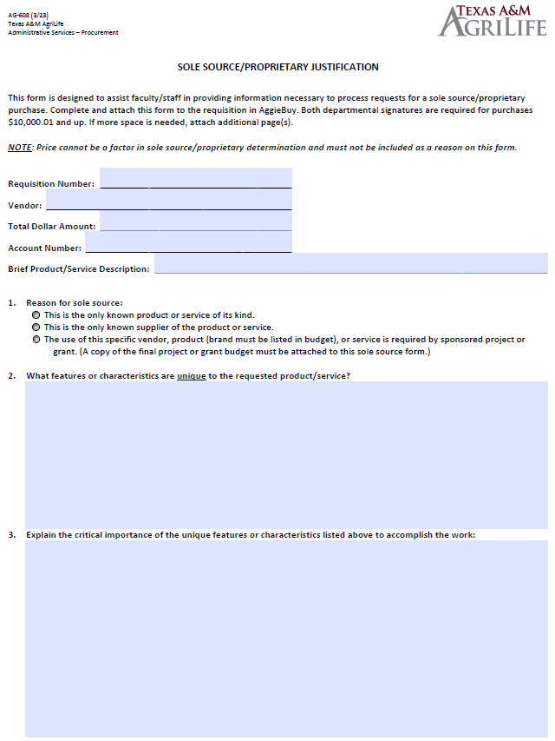
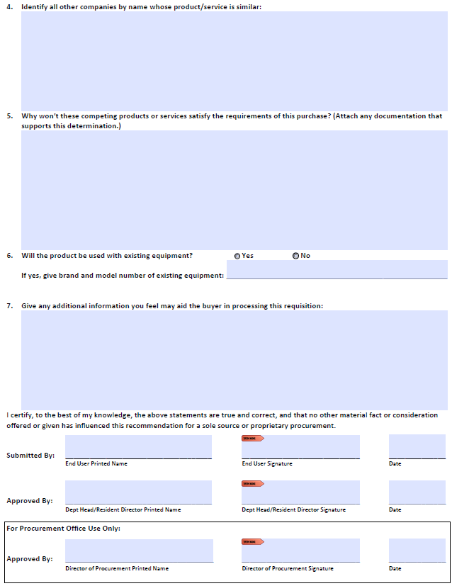
INTRODUCING…
NEW SOLE SOURCE FORM
AG-608
Single form for both products & services
Addresses audit topics of concern
Available online now
Old forms will be accepted until April 30th
After April 30th, requisitions with the old forms will be returned
Notes:
Combines products & services onto 1 document
Replaces AG-601 (products) and AG-602 (services)
Additional space in the text box fields
Addresses topics that were areas of concern during the most recent audit
Identify other companies to prove market research was done
Both signatures required (end user & dept head/resident director)

Slide 6
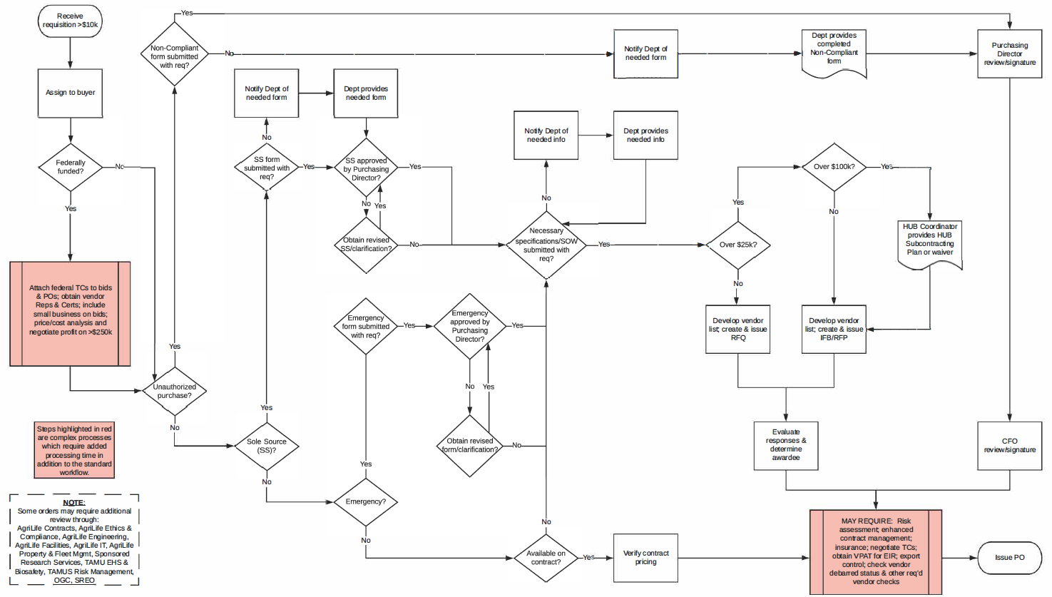
IT’S COMPLICATED
Processing 35-75 requisitions at any given time
Varying degrees of complexity
Often involves input from multiple areas of discipline
Notes:
Basic requisition process after it is assigned to a Buyer
If we have 75 reqs, that means each Buyer is following this process on 15 reqs at one time
Each step can require time
Some require significant time (red boxes)

Slide 7
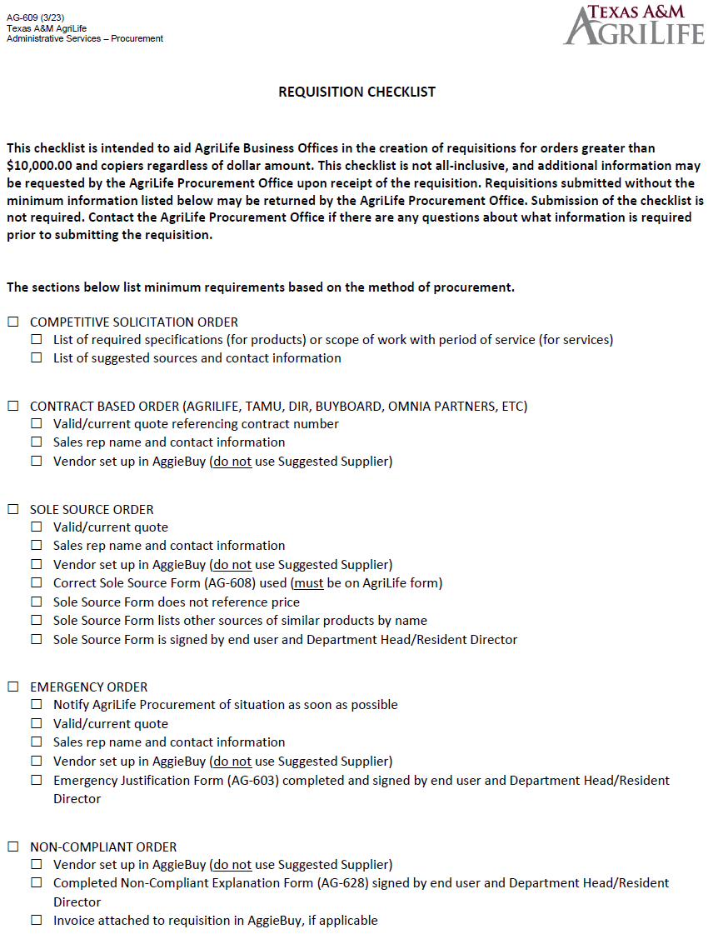
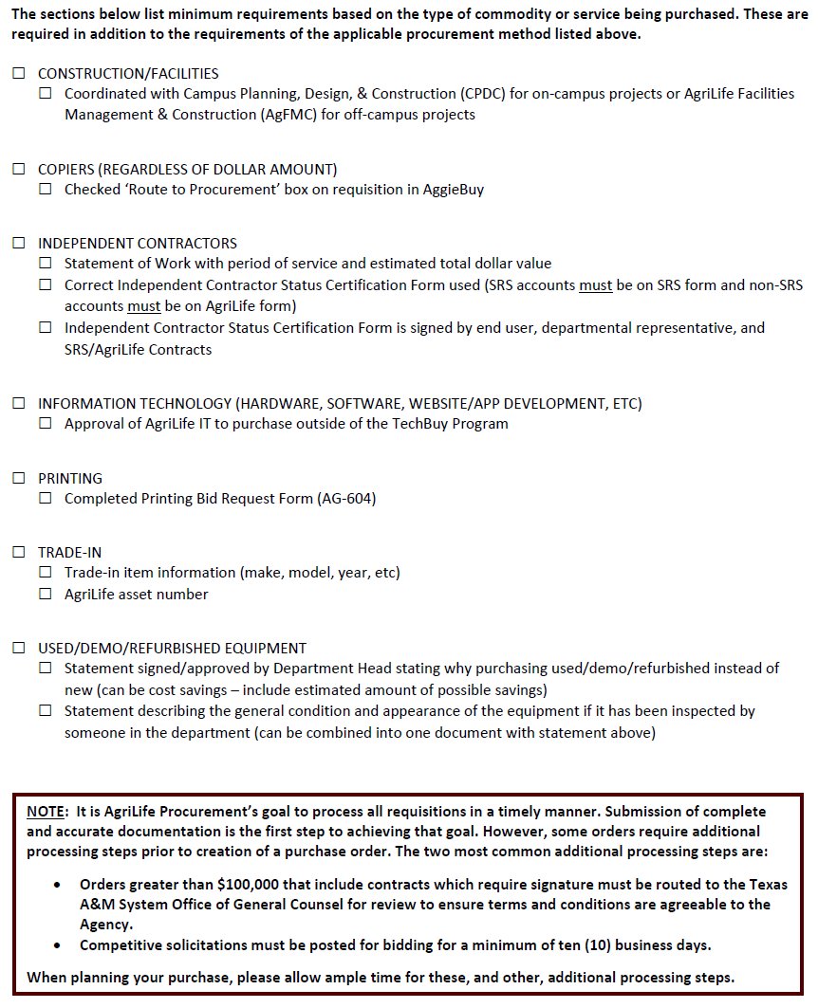
AG-609
INTRODUCING…
REQUISITION CHECKLIST
For orders >$10,000.00 and copiers regardless of dollar amount
Not all-inclusive – Buyers may ask for additional information
Requisitions submitted without the minimum information may be returned
Checklist submission is not required
Notes:
Reference document meant to aid business offices in creating requisitions that contain the necessary minimum information for AgriLife Procurement to begin processing
Submission of the checklist is not required
Only minimally addresses actual data entry in AggieBuy since our main concern is receiving accurate documentation to begin processing requisitions
This is a tool for you, but may be good to pass along to your end users, so they know what info you need

Slide 8
DON’T FORGET
Orders over $100,000 with contracts that require a signature must be reviewed and approved by OGC.
Competitive solicitations over $25,000 must be out for bid for at least 10 business days.
On a document in AggieBuy, use the Workflow (right side of screen) and History tab (top of screen) to view the past, present, and future of your document.
Submitting complete and accurate information with the requisition allows Buyers to focus on the more complex aspects of the procurement process.

Slide 9
CONTACT US
AgriLife Purchasing
Phone: 979-847-5801
Email: agpurchasing@ag.tamu.edu
Fax: 979-458-1217
Chris Chamberlain, Director
979-314-5830, cchamberlain@tamu.edu
Lindsay Weber, Assistant Director
979-314-5863, lrweber@ag.tamu.edu
Noel Mason, Senior Buyer
979-314-5846, anmason@ag.tamu.edu
Carsyn Burney, Buyer I
979-314-5839, carsyn.burney@ag.tamu.edu
Lainey Calder, Buyer I
979-314-2035, lainey.calder@ag.tamu.edu
Jessica Campbell, Buyer I
979-321-5347, jessica.campbell@ag.tamu.edu
Nick Galetka, HUB Coordinator
Phone Number, nick.galetka@ag.tamu.edu
Notes:
Thank you!

