Slide 1
AgriLife Employee
Development Symposium

Slide 2
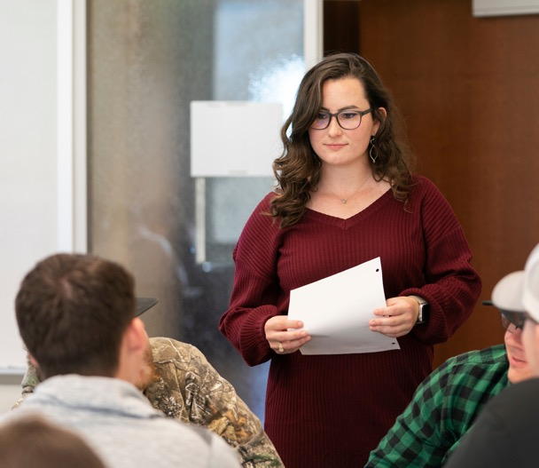
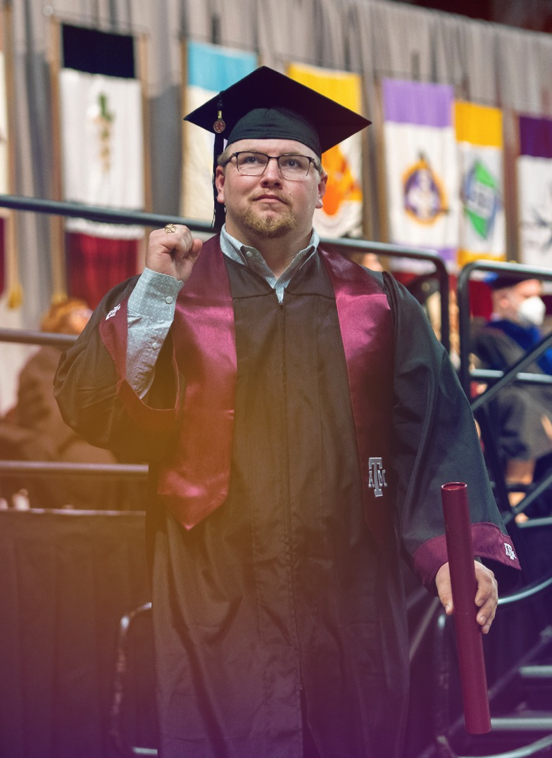
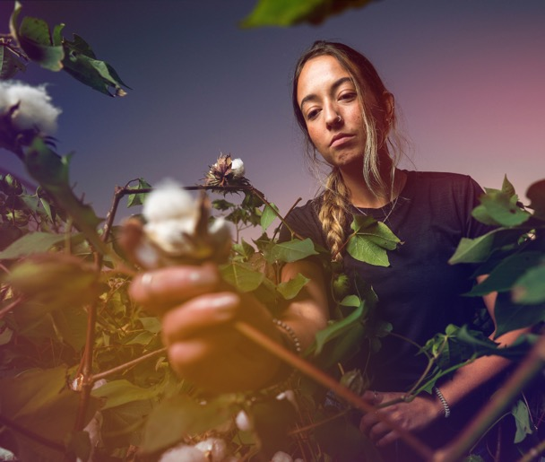
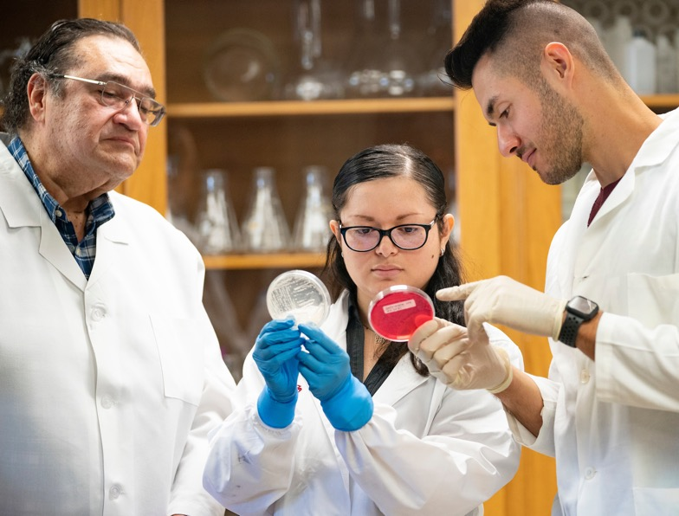
MARKETING & COMMUNICATIONS
Katherine Hancock
Assistant Vice Chancellor for Marketing and Communications

Slide 3
New Approach to Strategy and Service
Stronger together
More tools, more resources: We are all stewards of the brand!
Aligning platforms: Websites, news, events

Slide 4
WHO WE ARE
Katherine Hancock
Assistant Vice Chancellor, Marketing and Communications
Kim Topp
Associate Director, Marketing and Communications
Web Management
Marketing
Web Operations
Web Initiatives
Brand and Graphics
Photo/VIdeo
Mary Leigh Meyer
Assistant Director, Communications
Messaging
Social Media
Editorial Calendar
Digital Communications
Media Relations
Additional Areas
Internal/Executive Communications
Research Communications
Departmental Communications

Slide 6
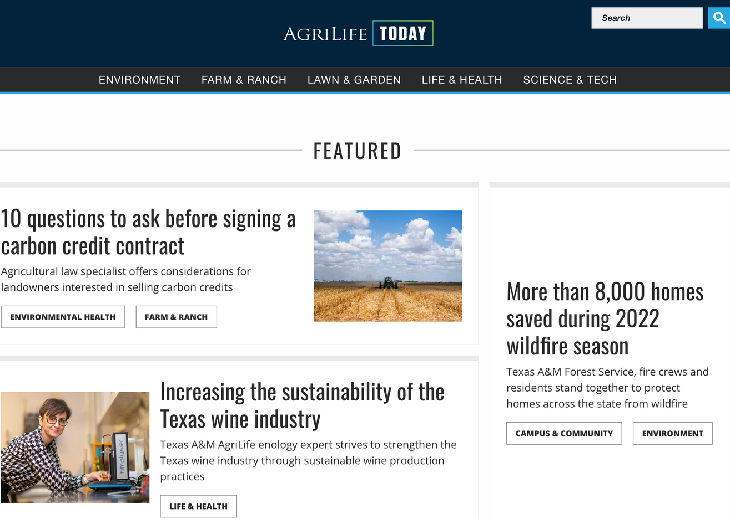
Your stories are our stories
News and Storytelling: We want to know what is going on!
Media Relations: We want to get our expertise in the news!
Social Media: We want to engage our community!
Crisis Communications: We want to protect our brands!

Slide 7
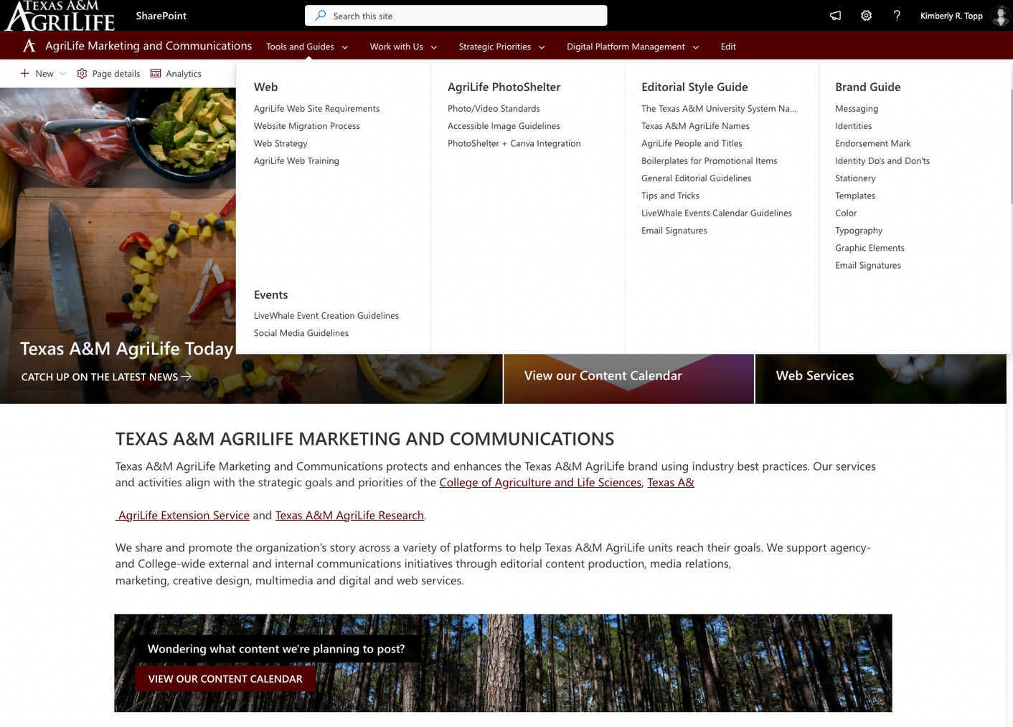
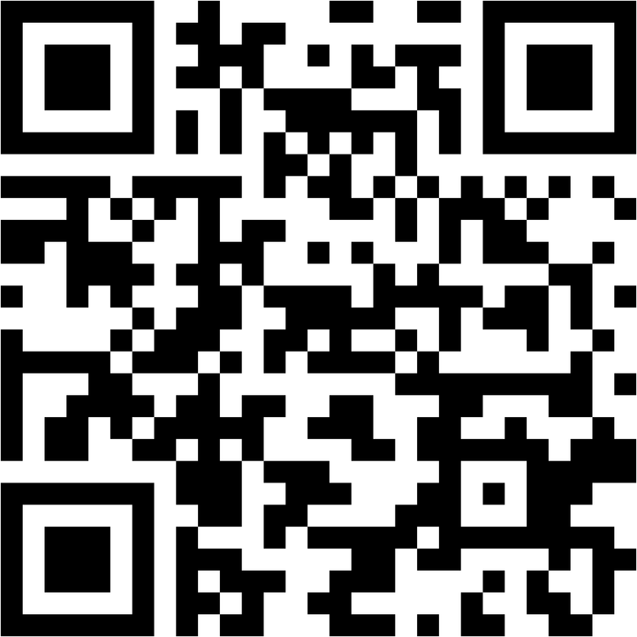
OUR TOOLS: INTRANET
Marketing and Communications Intranet: tx.ag/AgriLifeMarCommIntranet
Currently under a soft-launch. Will officially launch with the rest of the AgriLife enterprise intranets in spring 2023.

Slide 8
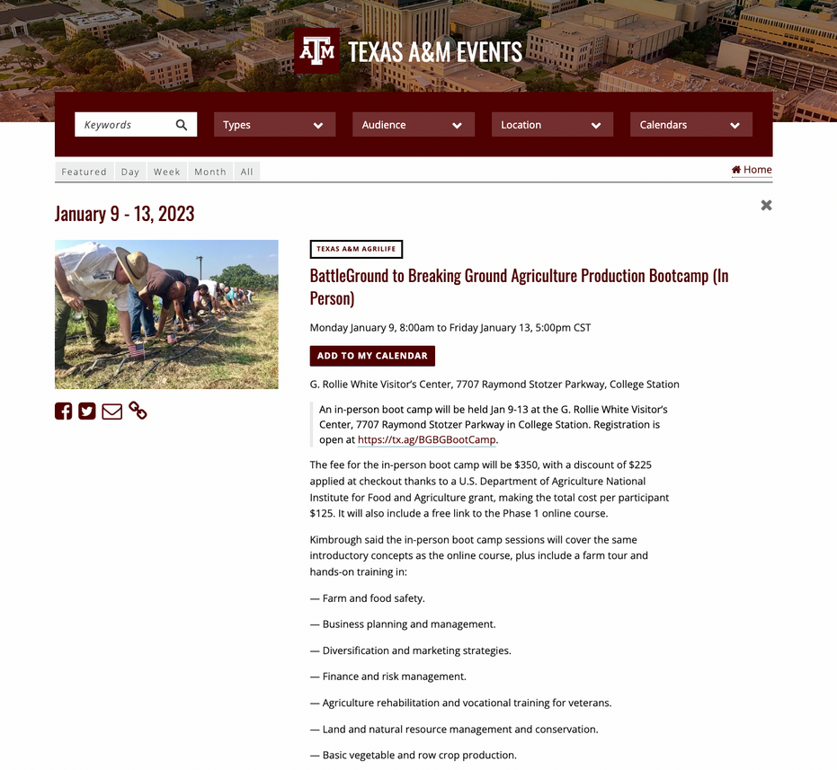
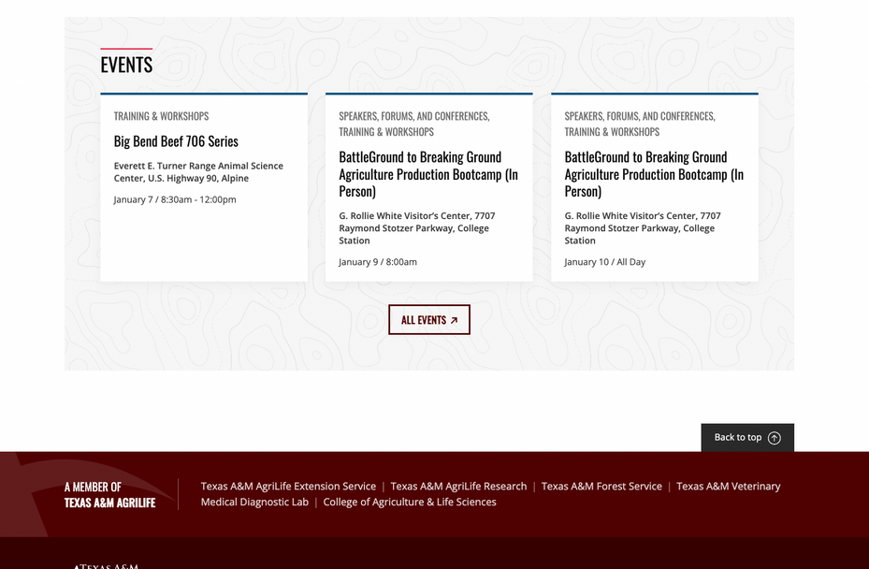
OUR TOOLS: LIVEWHALE
LiveWhale: An event calendar connected to sites across Texas A&M AgriLife.

Slide 9
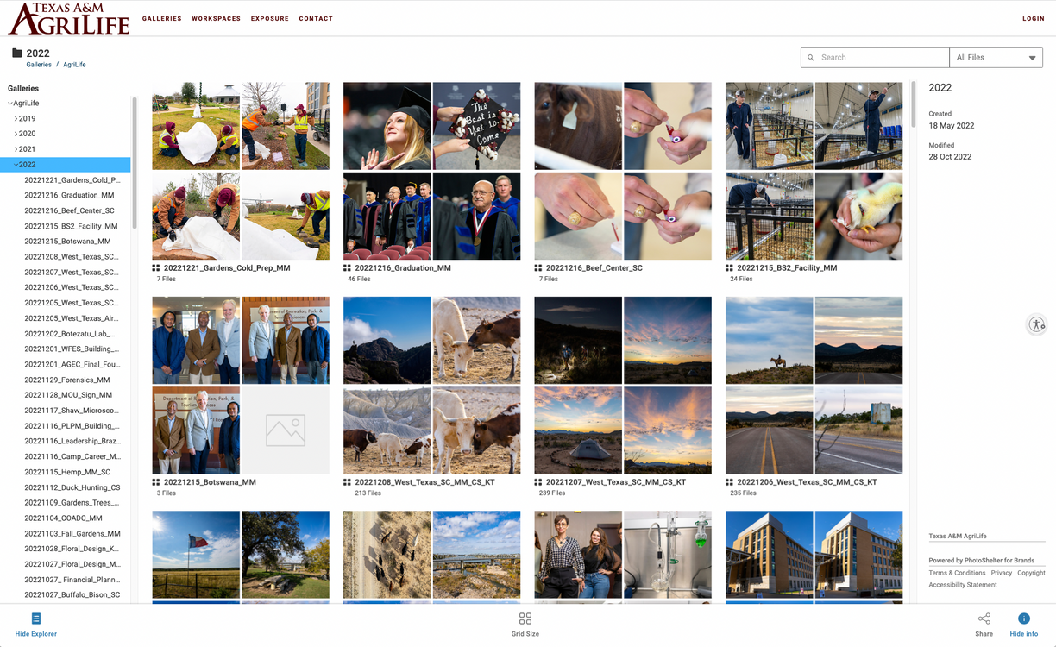
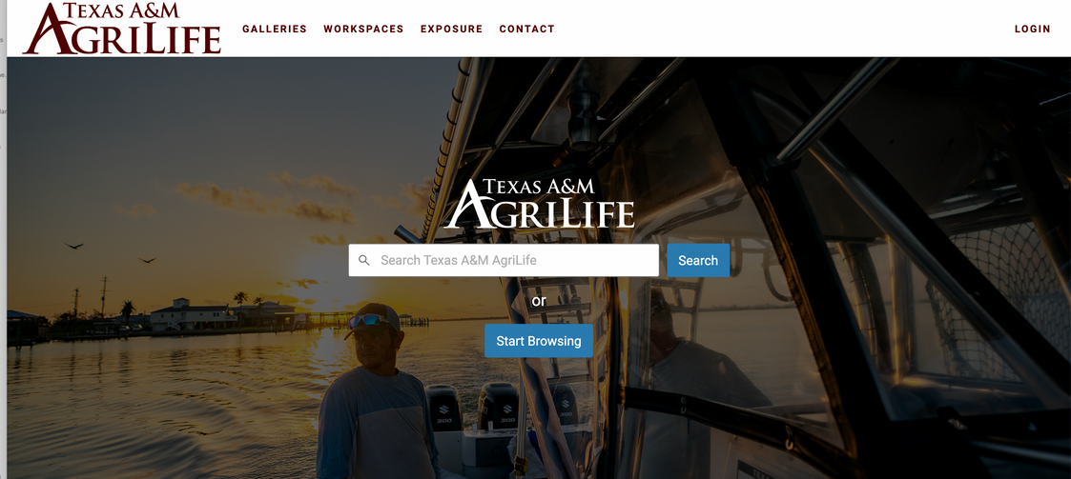
OUR TOOLS: PHOTOSHELTER
Photoshelter: More than 10,000+ images, free of charge at your fingertips
agrilife.photoshelter.com

Slide 10
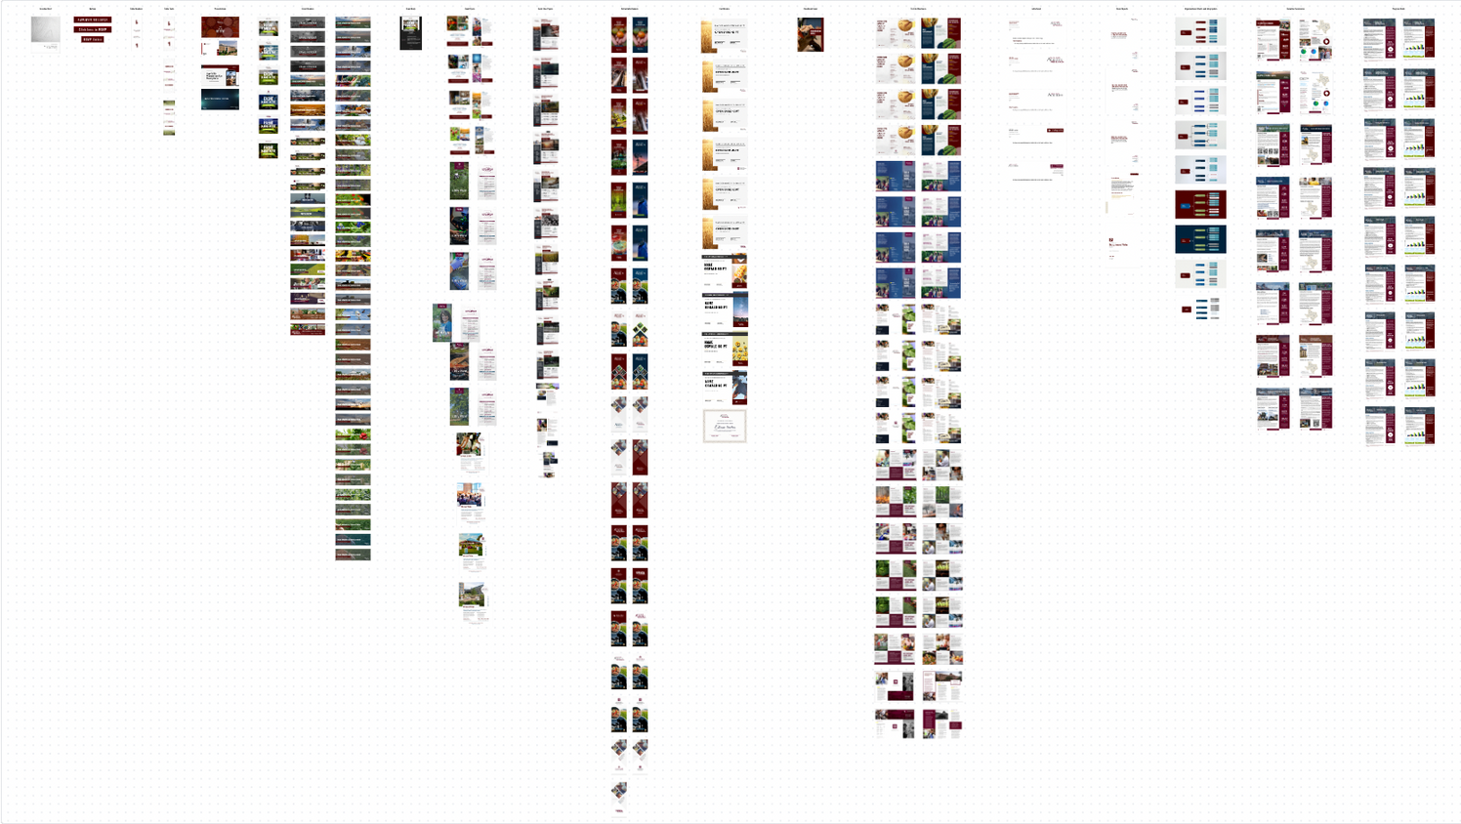
OUR TOOLS: CANVA
Auditing the 2021-22 templates to better understand what employees used and what we need to refresh for 2023.

Slide 11
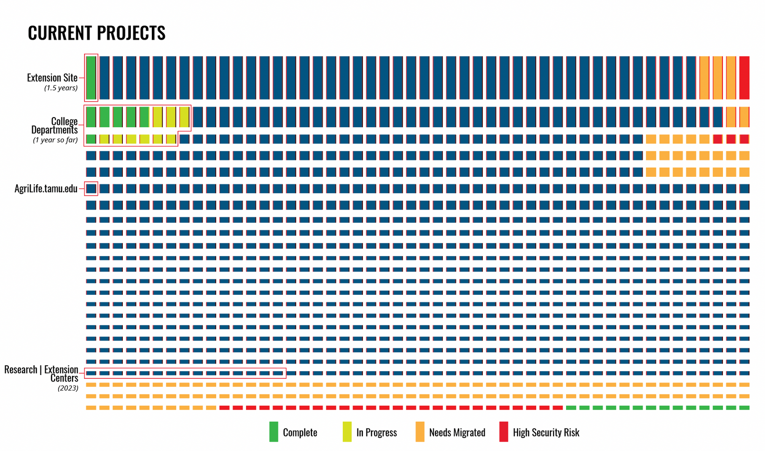
PUTTING WEB IN CONTEXT

Slide 12
MOVING FORWARD
The lift is huge and is a significant priority to meet our goals and remain a trusted and reliable resource.
Web Training: Any state website must meet certain criteria and anyone with access to create web content should understand the tool they are using and the legal requirements. We are working on courses to help with this.
Better Collaboration: We have to work together. Extension employees are the experts on their content - we cannot update or create websites without their help.
Accountability: There are dozens of sites with content over 10 years old.
What happens when that person is "bored" of the site or too busy or leaves the institution?
What happens when sites are created outside of our requirements?

